Slide 1

A COMPUTATIONAL TECHNIQUE FOR READABILITY PREDICTION
By: Shreyan Sanyal (EE2013/058)
Supervised by: Prof. Alok Kole

Slide 2
WHAT IS THIS … READABILITY? DO WE EVEN NEED THIS?
“READ” + “ABILITY”, i.e,
Will you understand what you read?
NO
Bankim Chandra Chattopadhyay
Shakespeare
YES
Upendrakishore Ray Chowdhury
Ba Ba Black Sheep

Slide 3
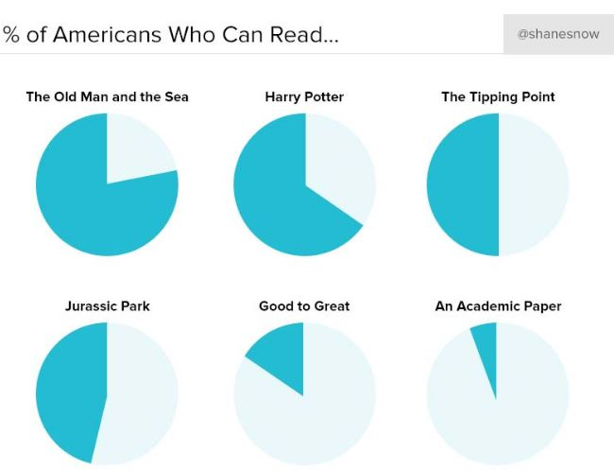
So, do we need this?

Slide 4
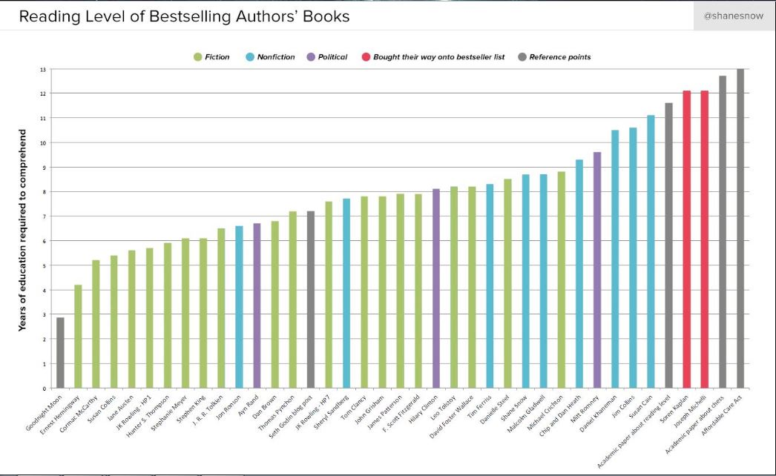
This thesis
Twinkle twinkle little star

Slide 5
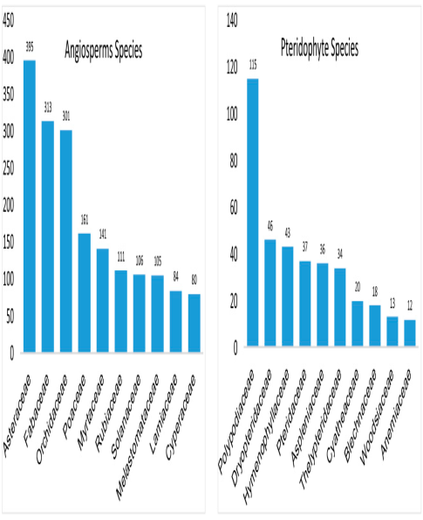
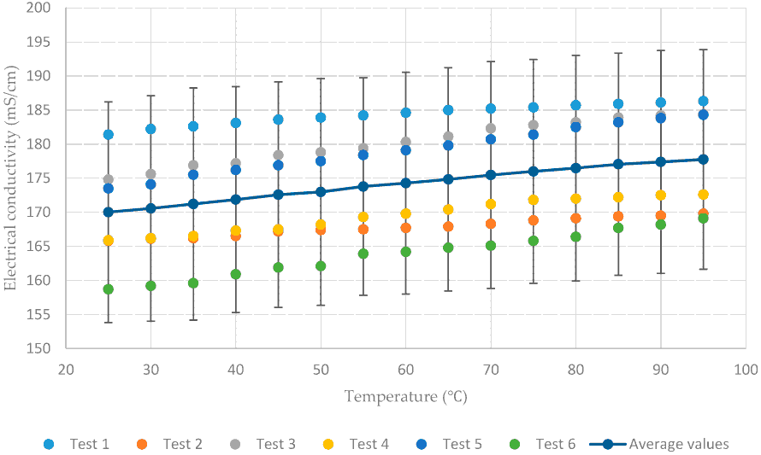

How do we do it?
Using machine learning.
Youtube suggestions
Anti-virus
Online ads
Self-driving cars

Slide 6
How do we do it?
new data (related to either x or y axes)

Slide 7
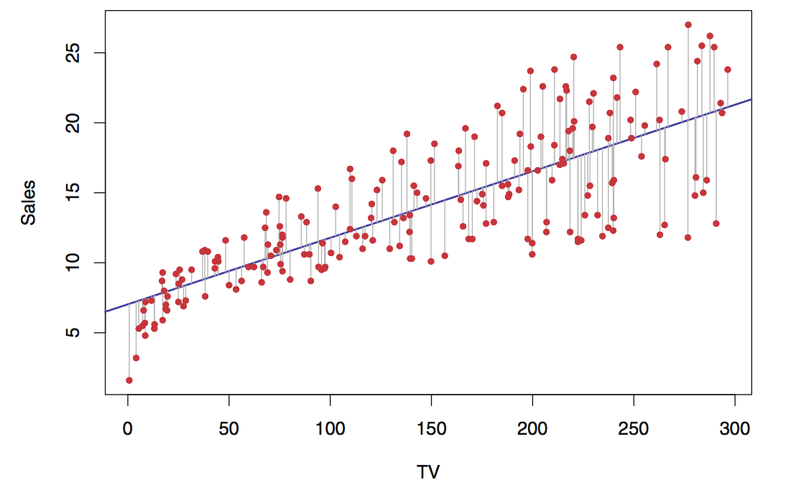
The simplest example of machine learning

Slide 8

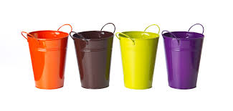
What do we do in this project?
Class 1
Class 3
college
Class 7

Slide 9

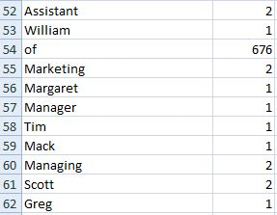
The algorithm
A student of class 10 (say)

Slide 10
The algorithm
A student of class 10 (say)

Slide 11
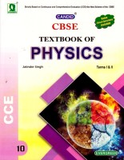
The algorithm
Textbooks of class 10

Slide 12
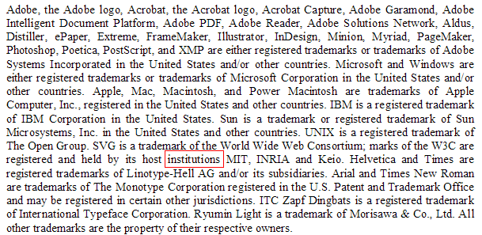

How do we test this?
Class 1
Class 2
…
…
…
Class 11
Class 12
“voltage”

Slide 13
What that formula means
Log-likelihood of text belonging to grade model i
Probability of a word being in grade model i

Slide 14
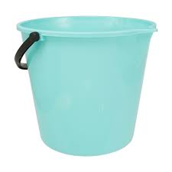
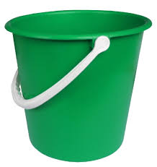
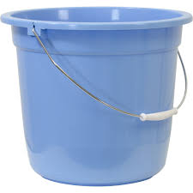
Finally…
Class 12
Class 1
Class 2
-1897.009
-908.76
-976.99

Slide 15
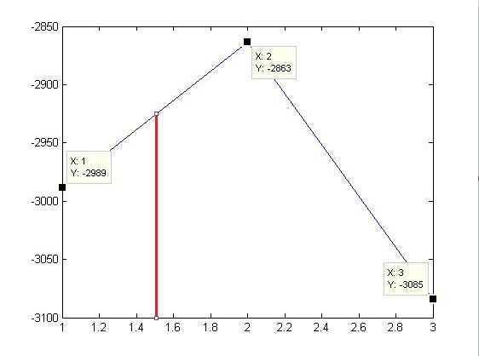
Lets see the plot!

Slide 16
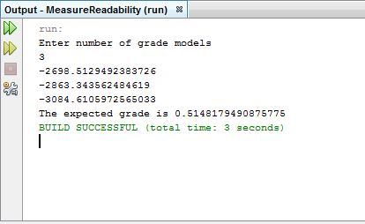
…the answer is

Slide 17


Theoretical Model: where did the formula come from?

Slide 18
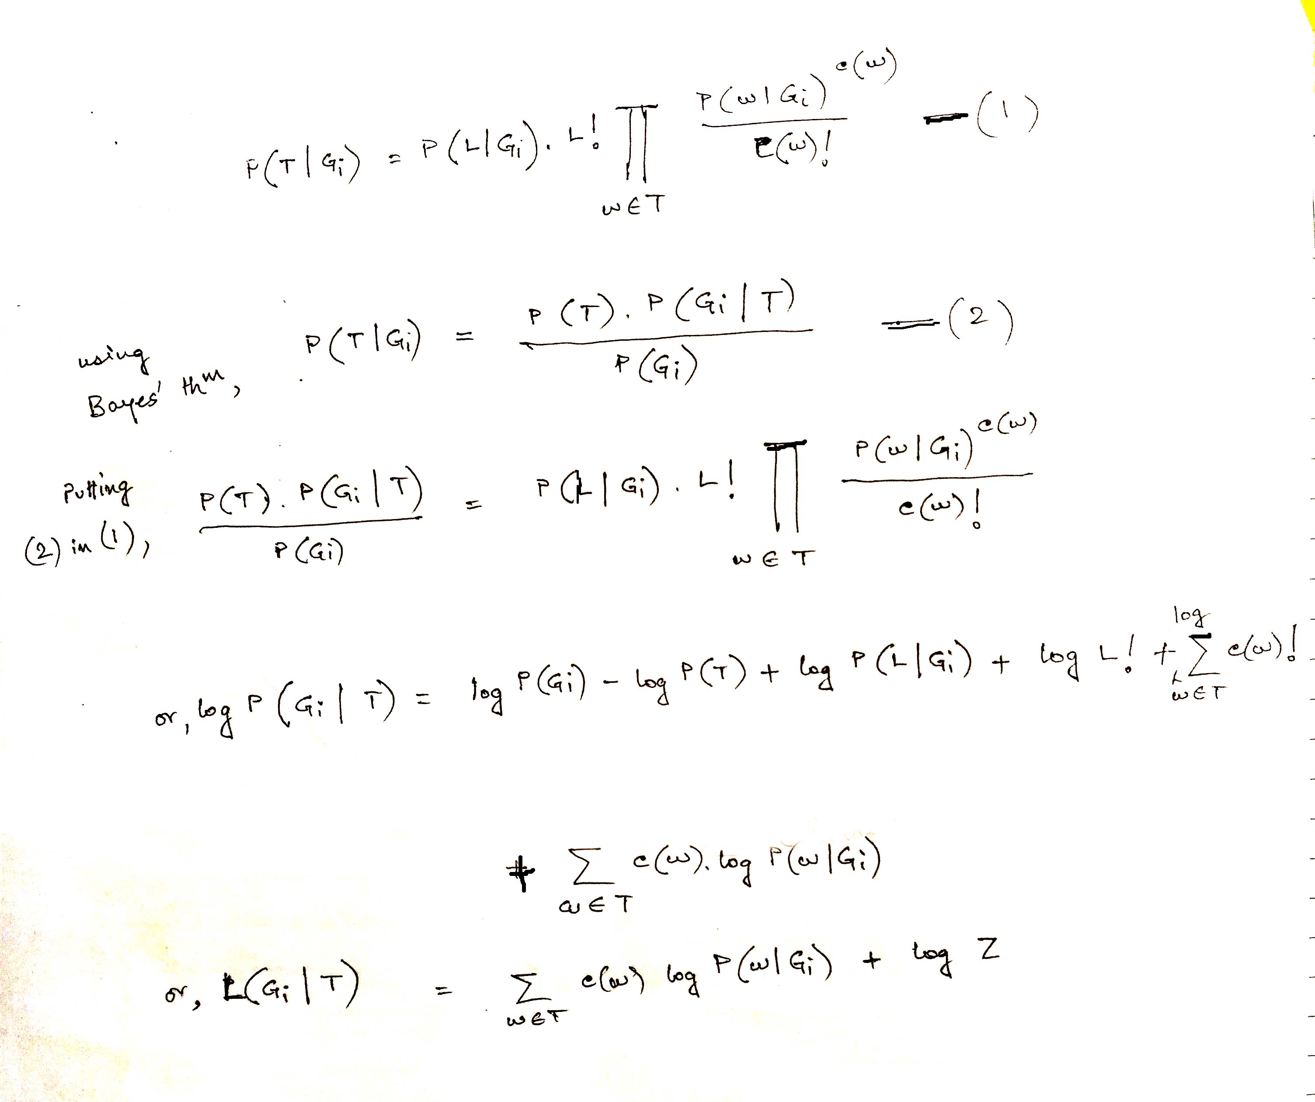

Slide 19
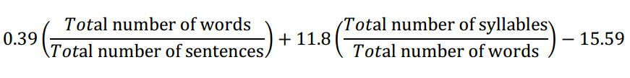
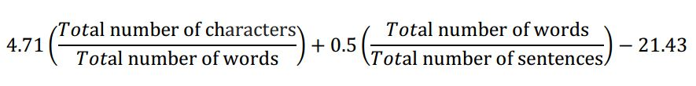
Readability formulae
Flesch-Kincaid Grade level formula
Automated readability index

Slide 20
Readability formulae
Flesch-Kincaid Grade level formula
Automated readability index

Slide 21
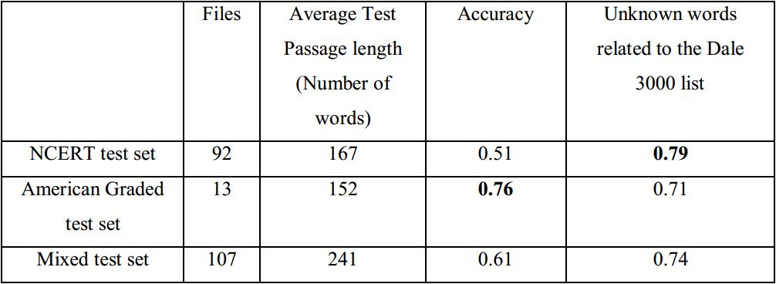
Observations
10-fold cross-validation
List of words everyone knows

Slide 22
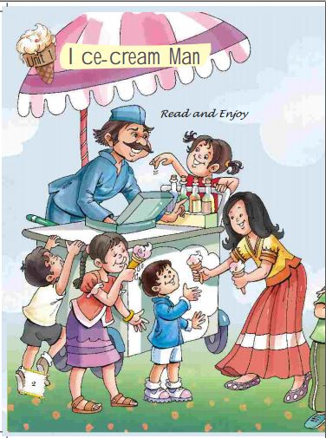
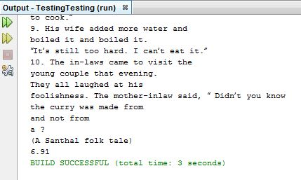
Interesting observation!
This is a class 5 CBSE textbook
Automated readability index result:
6.91!

Slide 23
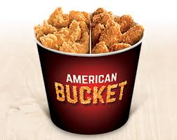
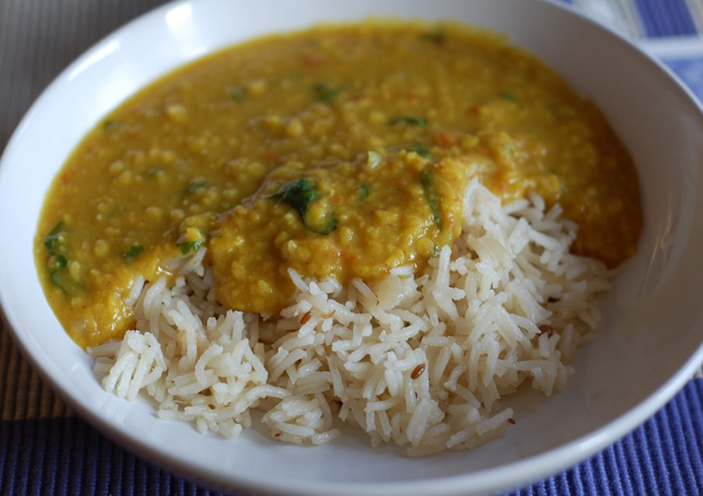
That means..
By an average of 1.58 grade levels

Slide 24
Thank You!

